Slide 1
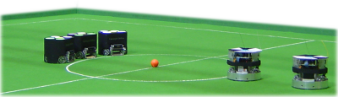
Introduction to robocup
robocup@mit.edu
Rfcbots.com

Slide 2
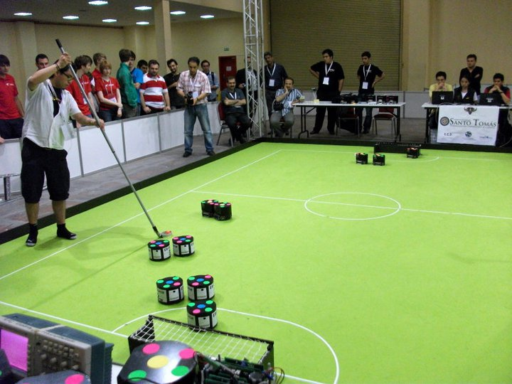
The plan
Robocup Overview
Mechanical
Electrical
Computer Science
Last notes
Pizza and questions!

Slide 3
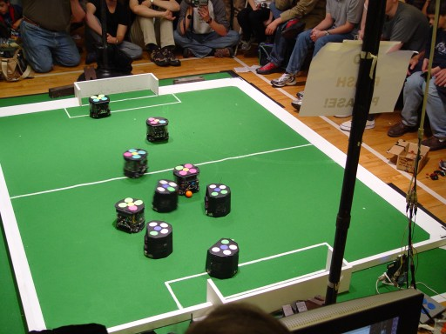
Gameplay – Small Size League
Five robots/team
18cm diameter, 15cm height
Play soccer with an orange golf ball
Two overhead cameras connected to an off-field computer
Cameras send bots’ info to computers
Teams send commands to the bots

Slide 4
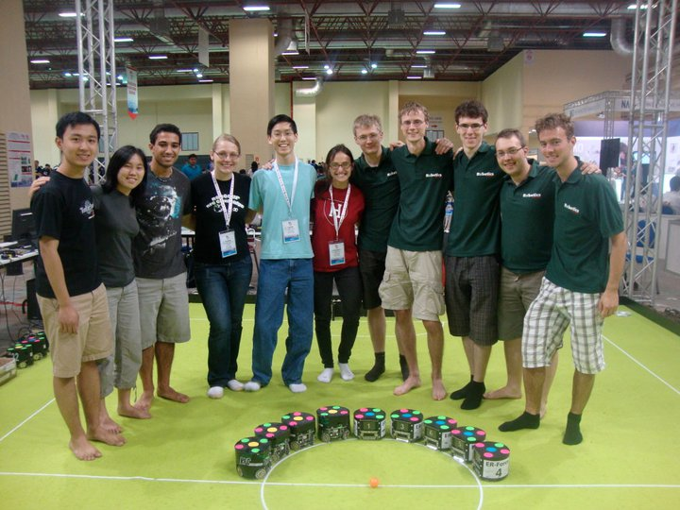
RFC-Cambridge
First competed in 2005
Harvard-MIT effort
International competitions in Istanbul, Singapore, Germany, Austria

Slide 5
What to expect
No background experience necessary
Weekly subteam meetings
Semesterly all-team meetings
Spring Semester North American competition???
Summer international competition

Slide 6
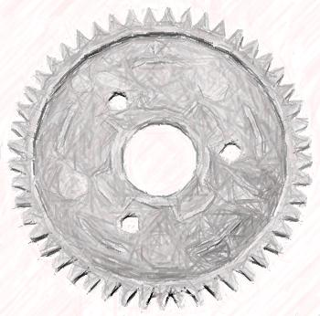
Mechanical subteam
What we do
How we do it
How we’re organized
What you’ll get out of it
Why RFC-ME?
What to expect
2012-2013 projects
Robocup ME
Notes:
<number>

Slide 7
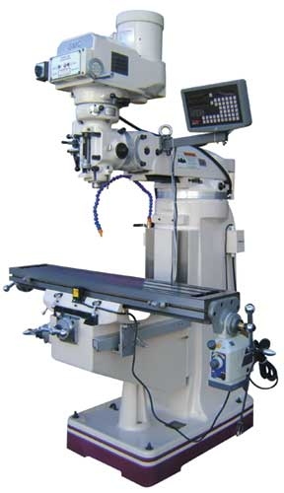
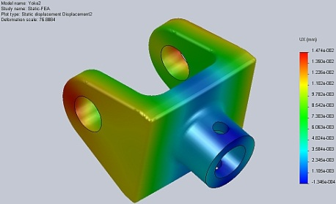
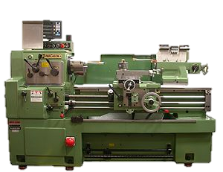
How we do it
Weekly meetings
Tools of the trade
CNC mills, lathes
Rapid prototyping
Solidworks CAD
Finite Element Analysis (FEA)
MATLAB, MathCAD
Notes:
<number>

Slide 8
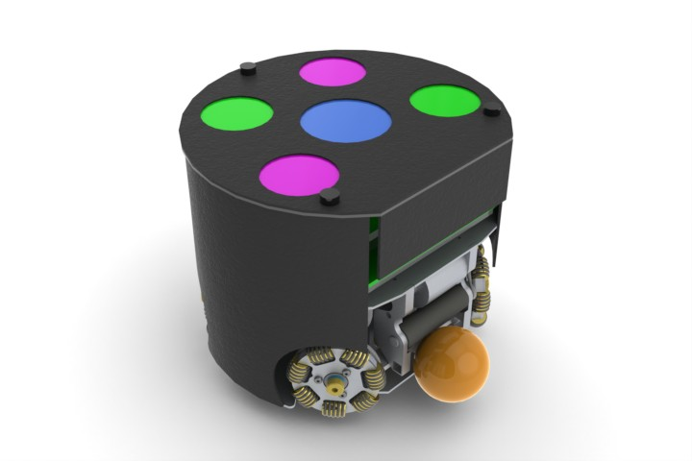
How we're organized
Constantly evolving
Lots of experience levels
Freshman-graduate
Older students mentor young'uns
2011 Robot rendering
Notes:
<number>

Slide 9
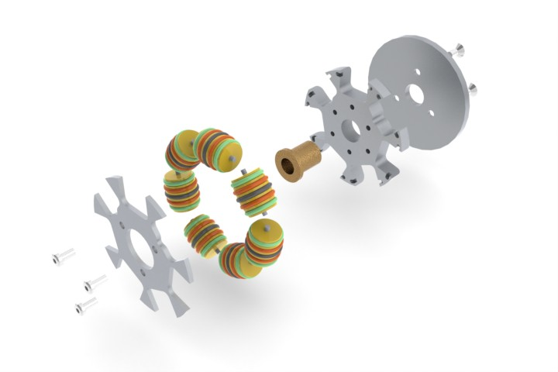
What you’ll get out of RFC-ME
Design experience: Mens et Manus
Critical! Only way to learn it is to do it
Manufacturing experience
Also critical!
Engineering team experience
Subtle, but critical!
Networking
Notes:
<number>

Slide 10
Why RFC ME?
Design experience: Mens et Manus
Critical! Only way to learn it is to do it
Manufacturing experience -DFM
Also critical!
Engineering team experience
critical!
Networking
Notes:
<number>

Slide 11
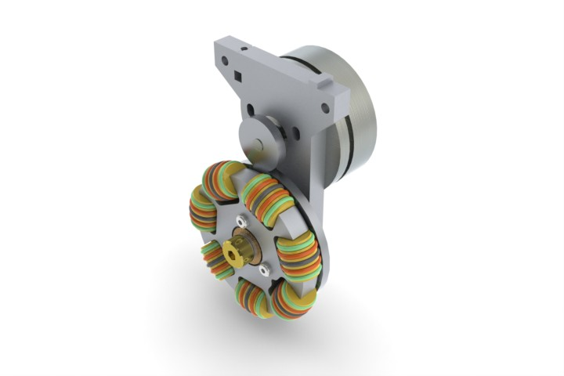
What to expect
Fluctuating time commitment
Weekly meetings typically 1.5 hr
Spikes before important milestones
Feb, June
Comfortable pacing
Take on as much work as you like
Freshman year will likely be an apprenticeship period
When ready, tackle design projects
Focus on learning
Ok to mess up! Failures are a source of insight, learning
2011 prototype omniwheel
Notes:
<number>

Slide 12
2011-2012 season ME projects
Hit the books – hard
Read other teams’ papers, journal articles
Assess state of the art
Benchmark
Run experiments; where do we stand?
Redesign -> prototype
Maintain current gen (Firefly squad) for other subteams
Notes:
<number>

Slide 13
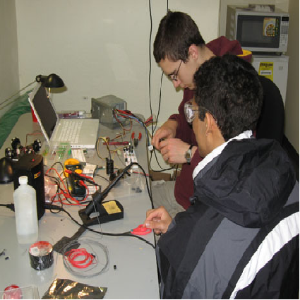
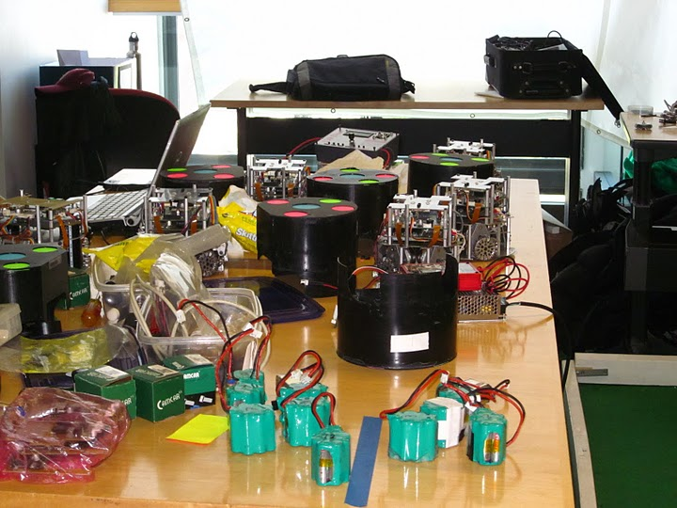
EE Subteam

Slide 14
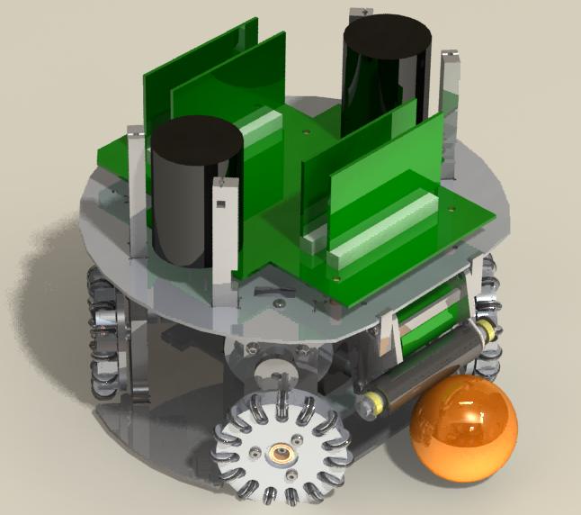
EE in the robot
Each robot function is controlled by a distinct circuit board – modularity
Driving: motor controller boards (4)
Kicking: kicker board; 450 volts!
Dribbling the ball: auxiliary kicker board
Communication: motherboard

Slide 15
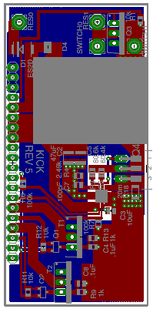
What can you learn?
EE skills about circuits, control, communication
Hands on lab experience
Soldering
oscilloscopes
etc.
Design experience – design and implement your own circuit board

Slide 16
How you can help!
No skills needed
Design circuit boards to validate critical components (motors, kicker, dribbler, etc.)
Interface with MechE and CS teams to optimize robot

Slide 17
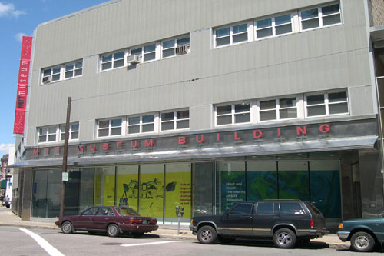
Where to find us
We meet once a week on Sunday afternoons behind the MIT Museum (N51)
Next Meeting: watch your e-mails!

Slide 18
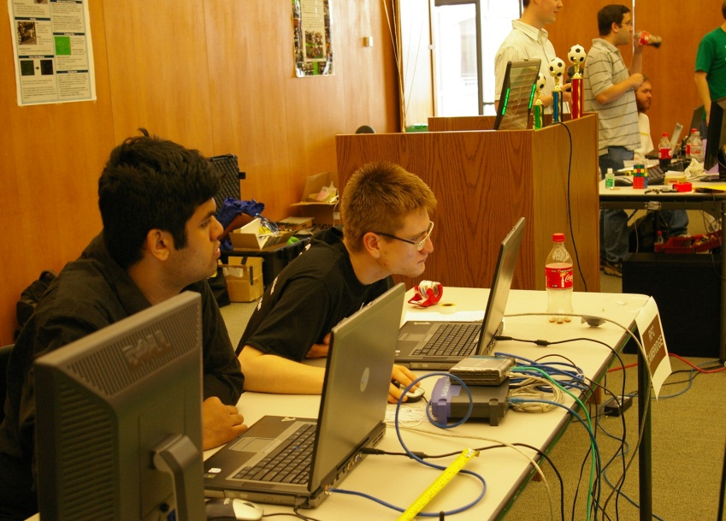
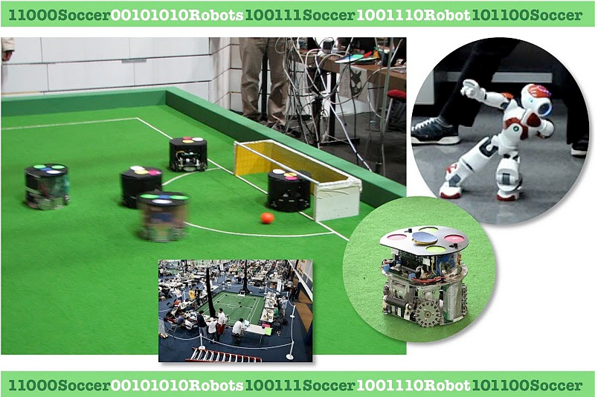
Computer Science Subteam
We write the code
… and make the bots do cool stuff

Slide 19
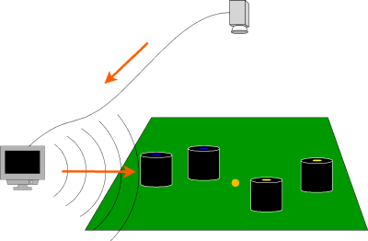
Overall System
Code runs on a PC
We use C# under Visual Studio 2010
10,000+ lines of code
1-20 people involved every year
(Some) documentation on http://wiki.rfccambridge.com/

Slide 20
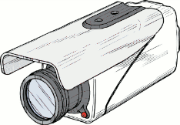

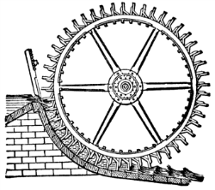
System Architecture
Vision
AI
Control

Slide 21
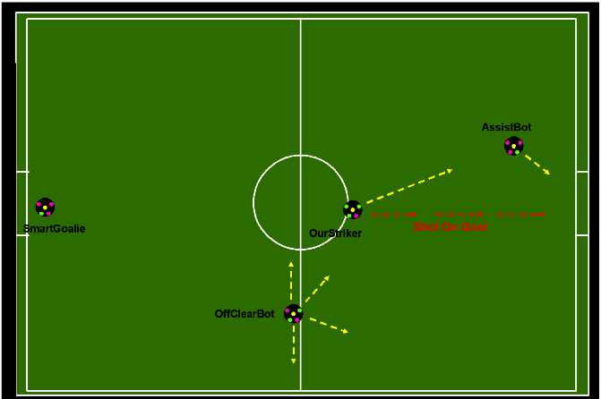
AI Strategy
Skills, tactics, plays
Play-language
Long-term vs. Short-term goals
All changes with opponent

Slide 22
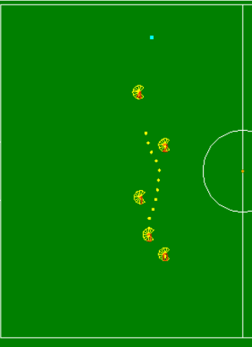
Motion Planning
Get from point A to point B
Avoid obstacles
Be fast
Cool algorithms involved

Slide 23

Why CS?
You love hacking!
… and want to learn how to write good code
It’s a real team and a real system
Very different from psets
Companies love that
Possible projects:
different playbooks, more strategies
dribbling, chip kicking?
passing, deflection shots
replay system

Slide 24
Why join Robocup?
Help from upperclassmen

Slide 25
Why join Robocup?
Help from upperclassmen
Experience

Slide 26
Why join Robocup?
Help from upperclassmen
Experience
Cross-university (get off campus every once in a while)

Slide 27
Why join Robocup?
Help from upperclassmen
Experience
Cross-university (get off campus every once in a while)
International experiences

Slide 28
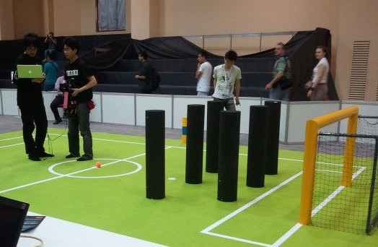
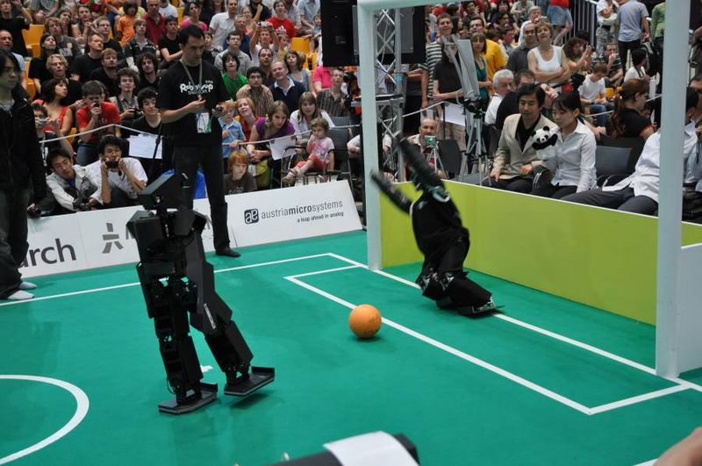
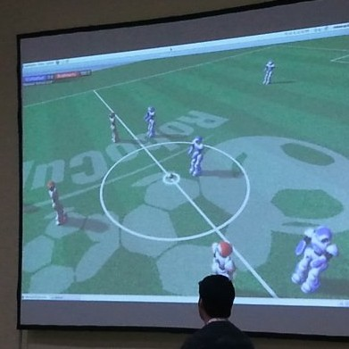
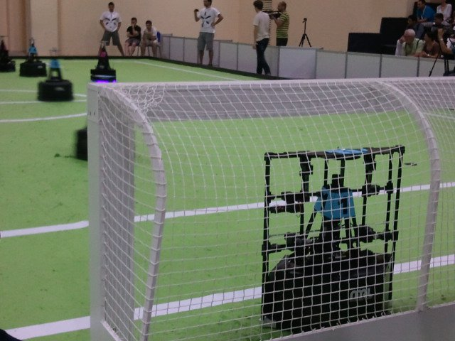
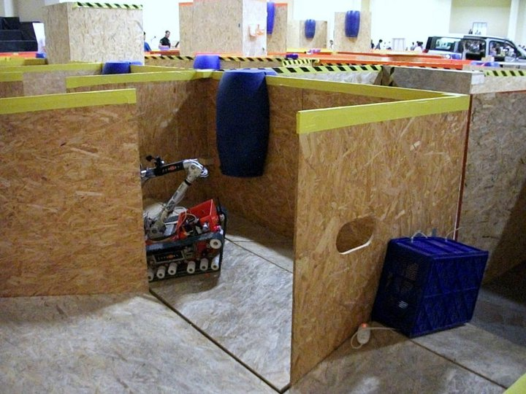
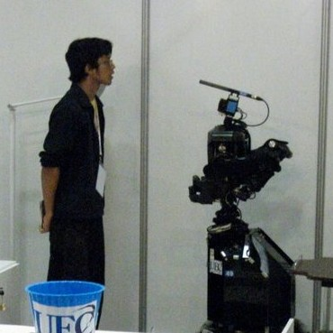
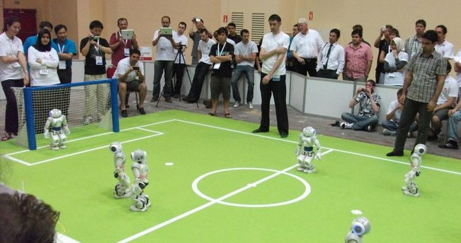
Mission from 1997:
Create a team of robots capable of beating the human world cup soccer team by 2050

Slide 29
Why join Robocup?
Help from upperclassmen
Experience
Cross-university (get off campus every once in a while)
International experiences
Robots are cool

